Slide 1

CAPSTONE PROJECT
EMPLOYEE SALARY PREDICTION
USING GRADIENT BOOSTING
ASHIQ BABU
Rajadhani Institute of Engineering and Technology
AICTE Internship Student Registration ID : STU6835cb65cc9691748355941

Slide 2


OUTLINE
Problem Statement
Future Scope
System Development Approach
References
Algorithm and Deployement
Result
Conclusion

Slide 3


💼 PROBLEM STATEMENT
Difficulty in identifying high-earning potential from employee data
Inconsistent and manual evaluation processes
No accessible system for non-technical users to analyze salary classifications
HR teams lack tools to make quick, data-backed salary assessments

Slide 4


🔧 SYSTEM APPROACH
🖥️ System Requirements
Device: MSI Cyborg (15 inch)
Processor: Intel Core i5 (13th Gen)
Graphics: NVIDIA RTX 2050
RAM: 12 GB
OS: Windows 11
IDE/Platform: Google Collab, Streamlit
📦 Libraries/Technologies Used
Python 3.13.3
Pandas – data loading & preprocessing
NumPy – numerical operations
Scikit-learn – model building (Logistic Regression, Random Forest, etc.)
Matplotlib & Seaborn – visualization
SHAP – model explainability
Streamlit – web app deployment
Joblib – model serialization
Plotly – interactive confidence gauge chart
LabelEncoder – categorical feature encoding

Slide 5

ALGORITHM & DEPLOYMENT
🔢 Step 1: Data Collection & Cleaning
🧹 Step 2: Preprocessing
🤖 Step 3: Model Training & Selection
🌐 Step 4: Web App Development
🔍 Step 5: Model Explainability (SHAP)
🚀 Step 6: Deployment

Slide 6

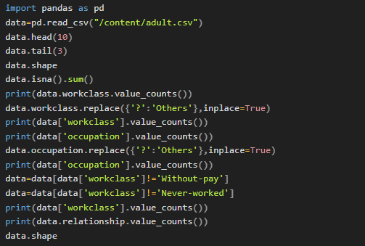

🔢 Step 1: Data Collection & Cleaning
Used the UCI Adult Dataset (CSV format)
Removed missing values (? replaced with “others”)
Dropped redundant features (e.g., education duplicate of educational-num)
Handled outliers (age, capital-gain, hours-per-week)

Slide 7
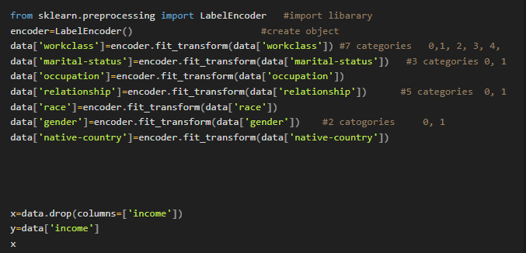
🧹 Step 2: Preprocessing
Label Encoding:
Converted categorical variables (workclass, occupation, relationship, race, gender, native-country, etc.) into numeric form using LabelEncoder.
Saved encoders for deployment.
Splitting Data:
Defined:
X: Independent features
y: Dependent variable (income)
Applied train_test_split(X, y) with 80% training and 20% testing.

Slide 8
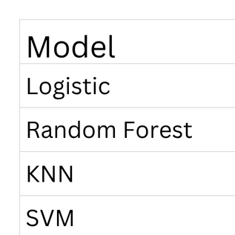
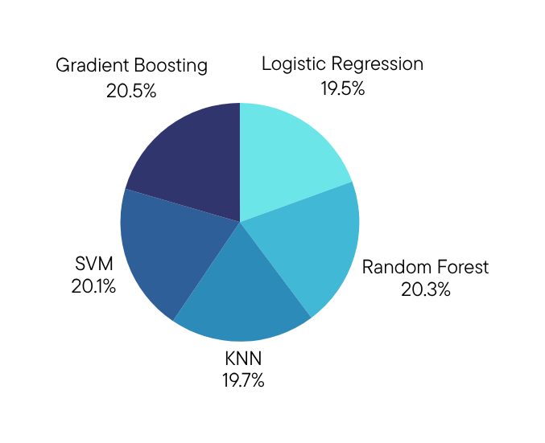
🤖 Step 3: Model Training & Selection
Machine Learning Models used:
Logistic Regression
Random Forest
KNN
Support Vector Machine
Gradient Boosting
Training Approach:
Each model trained using X_train and y_train
Evaluated using:
Accuracy Score
Classification Report (Precision, Recall, F1 Score)
Visual comparison using bar chart (Matplotlib)
Best Model Selection:
Based on accuracy
Best model saved using joblib.dump() for later use in the web app

Slide 9

🌐 Step 4: Web App Development
Framework Used: Streamlit
Functionality:
Sidebar to input:
Age, Education, Occupation, Gender, Hours per week
Encoded user inputs using pre-saved LabelEncoders
Made real-time predictions using the loaded best model (.pkl)
Displayed:
Predicted class (>50K or <=50K)
Confidence score
Input table (non-numeric)
User Interface Features:
Dark theme
Icon-based titles

Slide 10

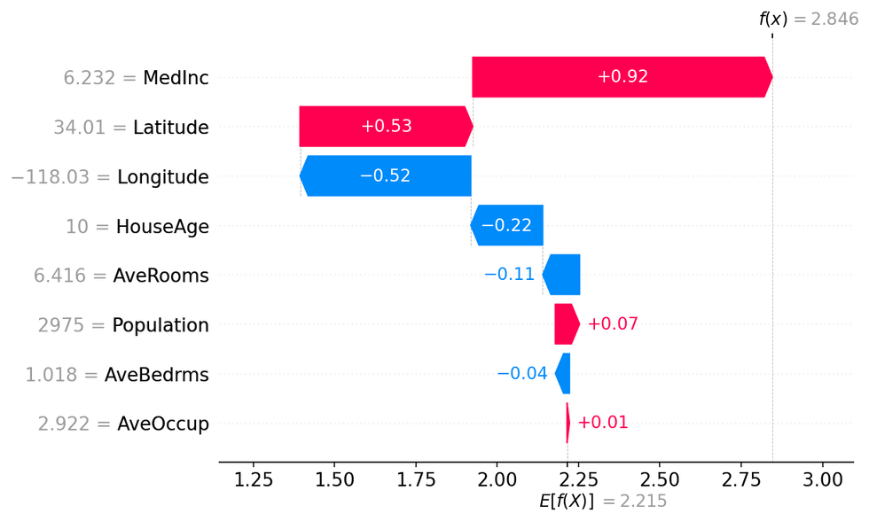
🔍 Step 5: Model Explainability (SHAP)
Tool Used: SHAP (SHapley Additive exPlanations)
Function:
Explains model prediction for each individual input
Visualizes the influence of each feature on the predicted class
Displayed using:
shap.plots.bar() for horizontal contribution graph
Color-coded to show positive (red) and negative (blue) impacts
fg - Example of SHAP Graph

Slide 11

🚀 Step 6: Deployment
Streamlit CLI:
App launched with streamlit run app.py
Ngrok Tunnel:
Generated a public URL via pyngrok for external users to access without local server setup
Batch Prediction:
CSV file upload option for multiple employee evaluations
Downloadable CSV with predicted classes

Slide 12
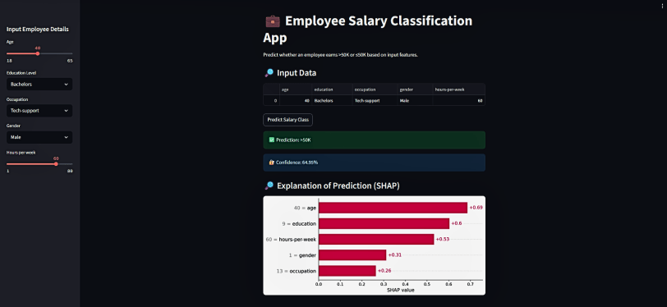
RESULTS
fg 2 - Output Image

Slide 13
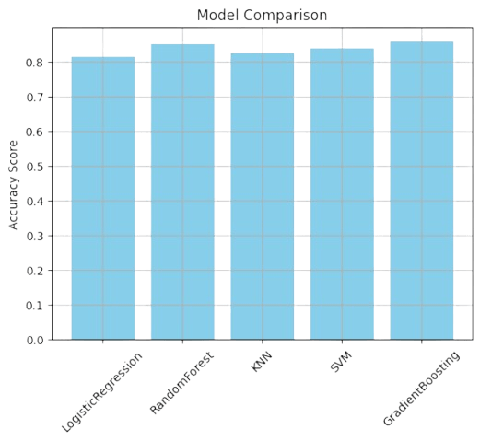
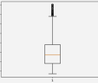
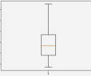
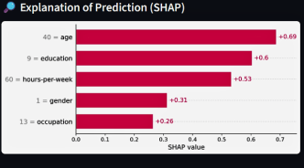
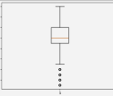
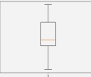
RESULTS
fg 3 - Model Comparison
fg 4 - Outliner Removing
fg 5 - SHAP grah
GitHub Link - https://github.com/ashiq1307/Employer_salary_prediction_gradientbossting.git

Slide 14
CONCLUSION
This project focused on predicting employee salary classification (>50K or <=50K) using machine learning on the UCI Adult dataset.
After training and evaluating multiple models — including Logistic Regression, Random Forest, KNN, SVM, and Gradient Boosting — the Gradient Boosting Classifier achieved the highest accuracy of ~85.7%, making it the final model for deployment.
The system offers a reliable, automated, and interpretable way to assess earning potential based on input features like age, education, occupation, and more.
The model was deployed using a Streamlit web app with features for:
Real-time predictions
Confidence scoring
Batch CSV uploads
Visual explanations using SHAP
This solution demonstrates how AI and ML can enhance decision-making in HR, analytics, and salary benchmarking.

Slide 15
REFERENCES
Matplotlib & Seaborn
Python visualization libraries
https://matplotlib.org/
https://seaborn.pydata.org/
Google Colab
Cloud-based Jupyter notebook environment used for model training
https://colab.research.google.com/
Scikit-learn Documentation
Machine learning models and preprocessing tools
https://scikit-learn.org/stable/
Streamlit Documentation
Building interactive web applications in Python
https://docs.streamlit.io/Streamlit Documentation
SHAP Documentation
SHapley Additive exPlanations for model interpretability
https://shap.readthedocs.io/en/latest/
Pandas Documentation
Data manipulation and analysis in Python
https://pandas.pydata.org/docs/

